Slide 1

OBJECT DETECTION AND RECOGNITION (FOR BLIND ASSISTANCE ) SYSTEM
UNIVERSITY INSTITUTE OF TECHNOLOGY, RGPV
DEPARTMENT OF COMPUTER APPLICATION
PARUL RANA (0101CA211041)
KRISHNA GOPAL PRAJAPATI (0101CA211032)

Slide 2
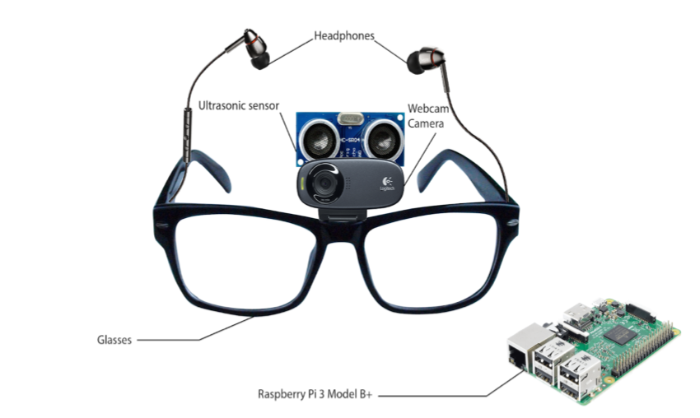
INTRODUCTION
THIS PROJECT IS AN ATTEMPT at DEVELOPING A SOFTWARE SYSTEM TO ASSIST BLIND PERSON USING SOME MODERN COMPUTER VISION TECHNOLOGIES.
WE ARE TRYING TO MAKE A COMPLETE SET OF SOFTWARE WHICH DEAL WITH THE IDENTIFICATION AND RECOGNITION OF THE OBJECT AND PROVIDES THE VOICE FEEDBACK OF THE OUTPUT IN EFFIECIENT MANNER WITH OBJECTIVE OF ASSISTINg THE BLIND PERSON.
FURTHER WE CAN ALSO ENHANCE THIS SYSTEM AS A SENSOR BASED SYSTEM IN WHICH A SENSOR SENSE THE OBJECT AND CALCULATE THE DISTANCE BETWEEN THE OBJECTS or DISTANCE BETWEEN THE SUBJECT-OBJECT.

Slide 3
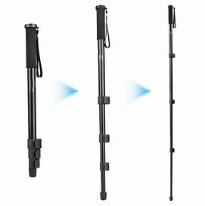
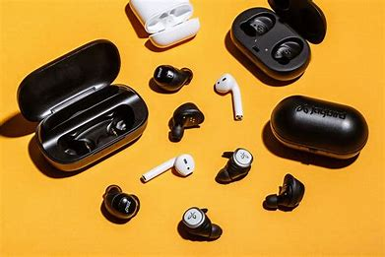
earbuds
camera

Slide 4
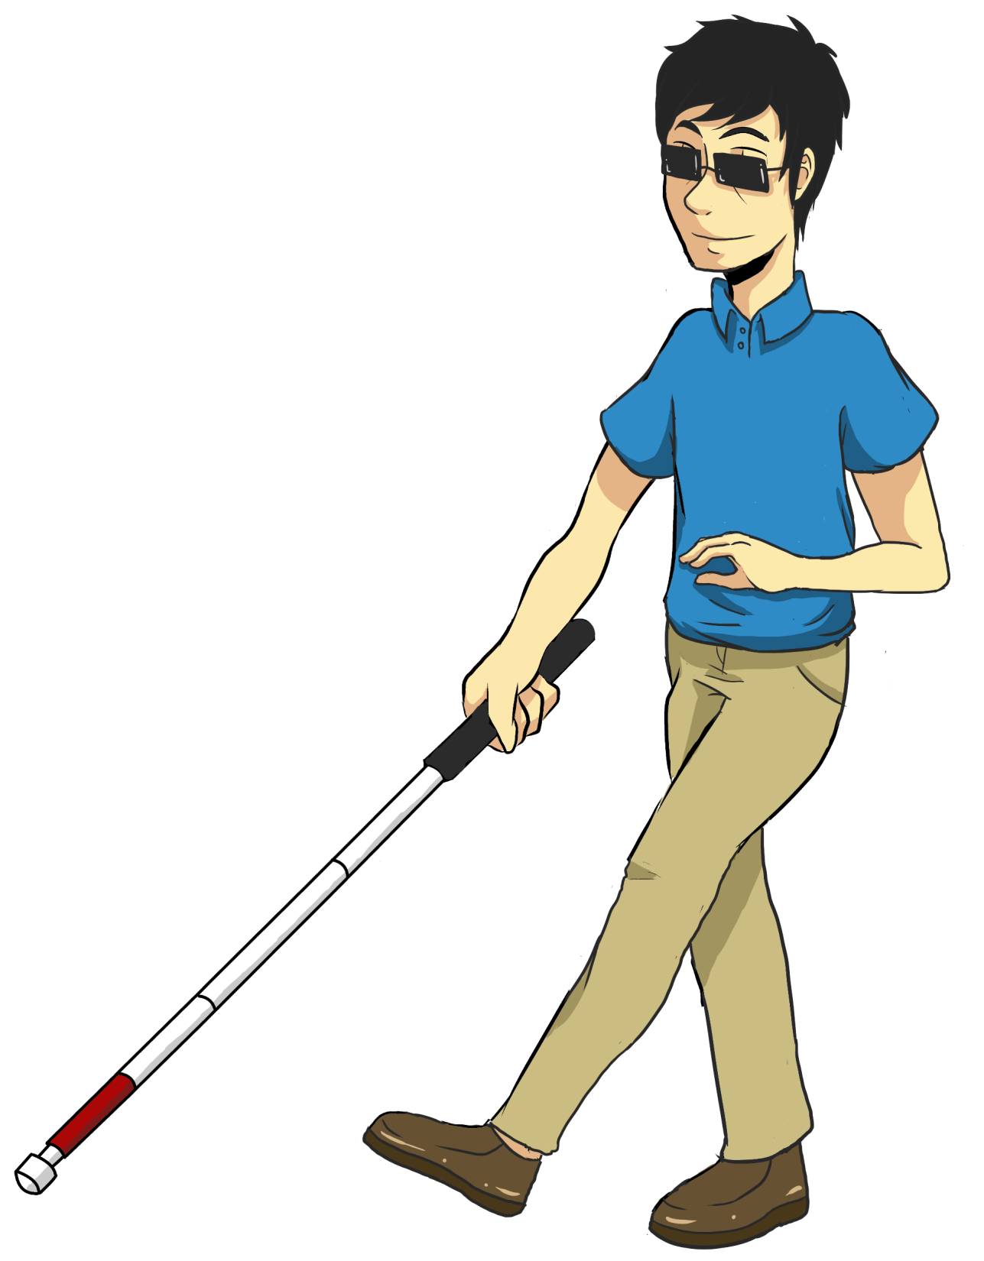
PROBLEM DOMAIN-
FOR BLIND PERSON OR VISUALLY IMPAIRED PERSON IT IS DIFFICULT TO SENSE THE OBJECTS IN THE INDOOR OR EXTERNAL ENVIRONMENT.
A PERSON CAN ASSIST THE VISUALLY IMPAIRED PERSON BUT IT ALSO HAVE LIMITATIONS, A PERSON CANNOT REMAIN WITH A BLIND PERSON ALL THE TIME IN ORDER TO ASSIST THEM IN RECOGNISING OBJECTS.
SO AS SOLUTION DOMAIN, WE CAN CREATE AN ARTIFICIAL SYSTEM TO ASSIST THE BLIND PERSON ALL THE TIME IN ORDER TO SENSE THE OBSTACLES OR OBJECTS/RECOGNISING THINGS THAT TELLS THEM THE NAME AND DISTANCE OF THINGS FROM RESPECTIVE POINT WHICH THEY FACE IN INDOOR OR EXTERNAL ENVIRONMENT USING COMPUTER VISION TECHNOLOGIES.

Slide 5
SET OF GOALS-
STORE THE CAPTURED IMAGE
SUBJECT/BLIND PERSON
INPUT FROM THE WEBCAM OR USING EXISTING DATA
IT CAN ALSO BE TREATED AS THE STAGES OF IMPLEMENTATION AS IT SUGGEST THE FLOW DIAGRAM IN ASCENDING MANNER OF IMPLEMENTATION.
CAPTURE IMAGE
PREPROCESSING
OF THE IMAGE
INDETIFY OR DETECT THE OBJECTS FROM THE CAPTURED OR EXISTING IMAGE
GENERATE AN VOICE FEEDBACK FOR THE IDENTIFIED OBJECT
VOICE OUTPUT
LAPTOP

Slide 6
SYSTEM REQUIREMENTS-
HARDWARE REQUIREMENT-
A SMART DEVICE WITH CAMERA FEATURE(AS IN OUR CASE WE ARE USING WEBCAM)-ALSO USE CAP-CAMERA,BUTTON CAMERA, SPECTACLE CAMERA
SPEAKER
SENSOR(FOR SENSOR BASED SYSTEM USING CANE STICKS ETC.)
SOFTWARE REQUIREMENT-
IDE(INTEGRATED DEVELOPMENT ENVIRONMENT),OPENCV,MACHINE LEARNED DATSETS
PYTHON PROGRAMMING LANGUAGE,PYTHON MODULES(OPENCV,MATPLOLIB,OS ETC)

Slide 7


OVERVIEW-
ALGORITHM
+
NETWORK ARCHITECTURE
API(APPLICATION PROGRAMMING INTERFACE)
gTTs(Google Text to Speech)
CNN(CONVOLUTIN NEURAL NETWORK)
TRAINING DATA
ssd_mobilenet_v3_large_coco_2020_01_14.pbtxt
OUTPUT-VOICE FEEDBACK
Lable.txt file
NAME 1
NAME 2
OBJECT1
OBJECT2
INPUT DATA

Slide 8
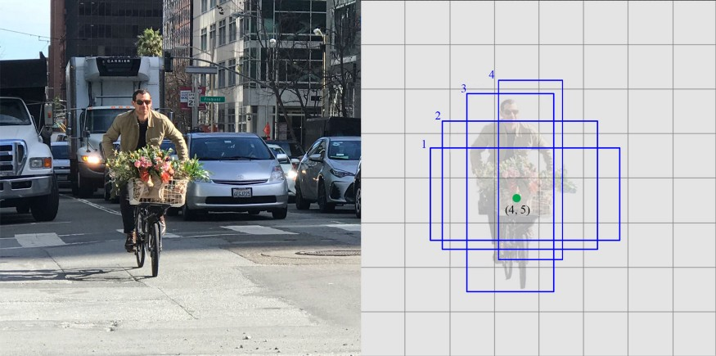
TRAINING DATASET MODEL USED FOR OBJECT DETECTION
ssd_mobilenet_v3_large_coco_2020_01_14.pbtxt
SSD(Single Shot/stage multibox detector)
mobilenet
Coco (Common object in context)
Dataset for computer vision
The mobilenet-ssd model is a Single-Shot multibox Detection (SSD) network, intended to perform object detection. In simple words this file is a pre-trained Tensorflow model and has already been trained on the COCO dataset.
Lable text
Larger scale objects
framework
Network model

Slide 10
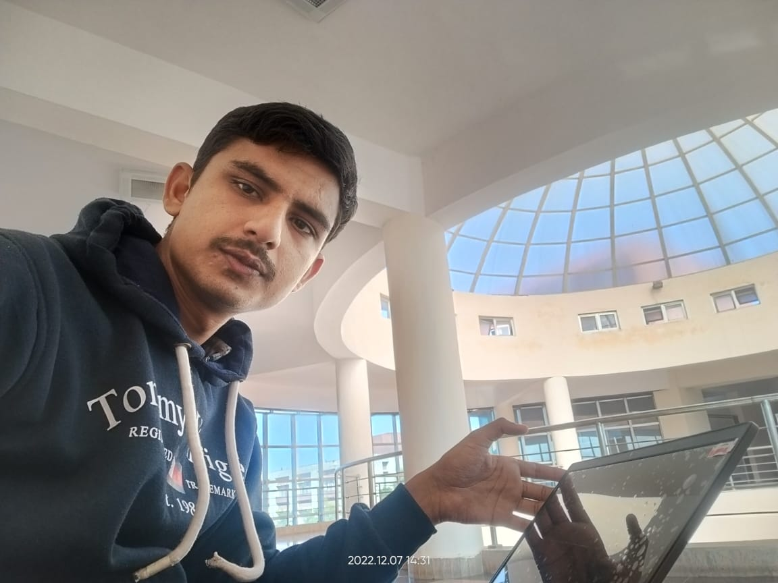
Maximum overlap

Slide 11
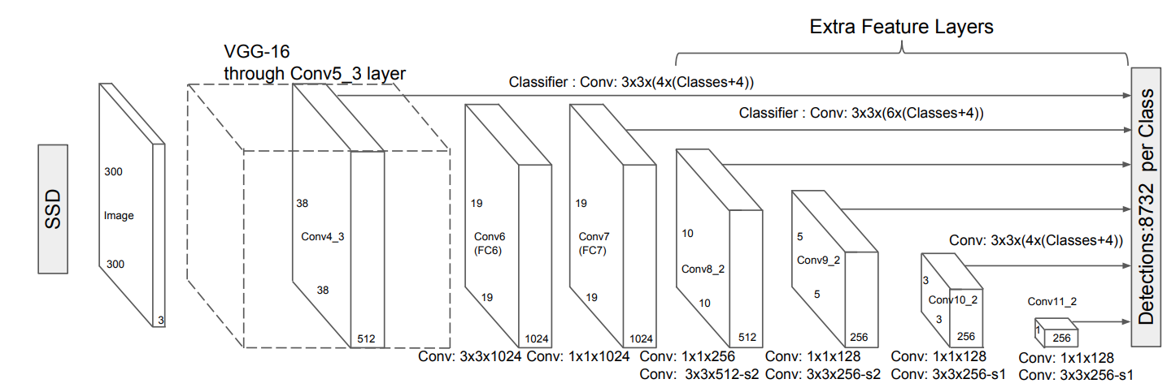

Ssd mobilenet architecture-
The SSD architecture is a single convolution network that learns to predict bounding box locations and classify these locations in one pass. Hence, SSD can be trained end-to-end. The SSD network consists of base architecture (MobileNet in this case) followed by several convolution layers:

Slide 12
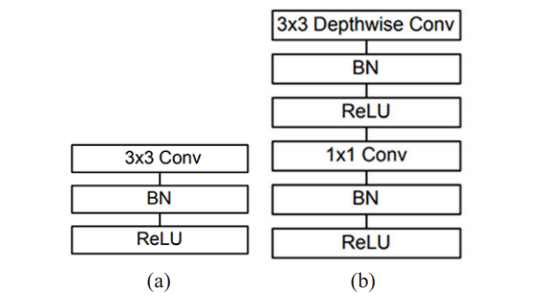
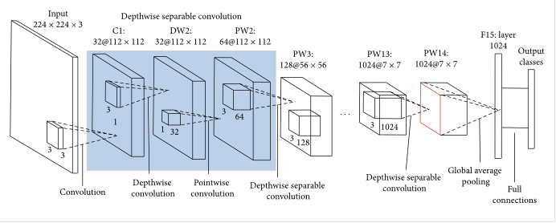
the MobileNet model is designed to be used in mobile applications, and it is TensorFlow’s first mobile computer vision model.
MobileNet uses depthwise separable convolutions. It significantly reduces the number of parameters when compared to the network with regular convolutions with the same depth in the nets. This results in lightweight deep neural networks.
Batch normalization

Slide 13
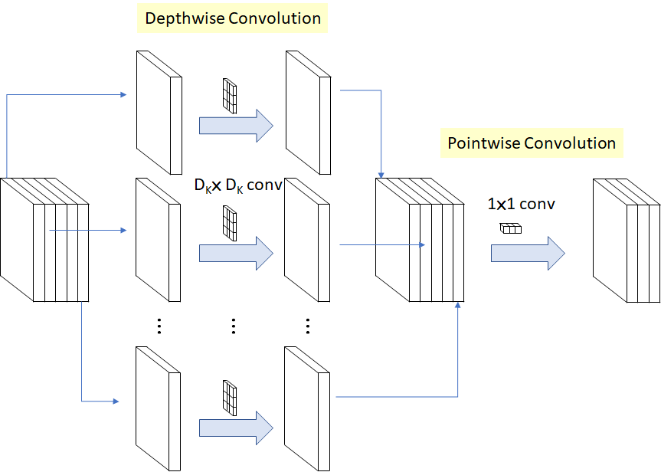

Slide 14
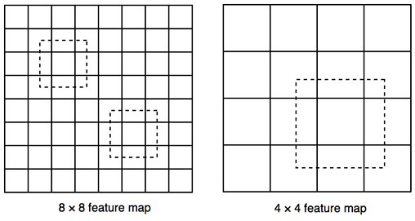
Higher-resolution feature maps are responsible for detecting small objects. The first layer for object detection conv4_3 has a spatial dimension of 38 × 38, a pretty large reduction from the input image. Hence, SSD usually performs badly for small objects comparing with other detection methods. If it is a problem, we can mitigate it by using images with higher resolution.
ssd
The biggest drawback of the SSD framework is the fact that its performance is directly proportional to object sizes meaning that it doesn’t fare too well on object categories with small sizes as compared to other approaches such as the family of R-CNNs [1,2]. This is because small objects may not contain any useful information in the top layers of the network that can be fruitfully used for detection. Therefore, data augmentation techniques are commonly used to randomly crop and resize certain parts of the image to help the network more easily identify and learn features for small object categories. Moreover, this is also why increasing the input resolutions of the images from 300x300 to 512x512 provides better results on both the MS COCO and Pascal VOC datasets [1]. Therefore, in our work, we conduct experiments that highlight the difference in the performance of networks trained using data augmentation and without.
Lower resolution feature maps (right) detects larger-scale objects.

Slide 15
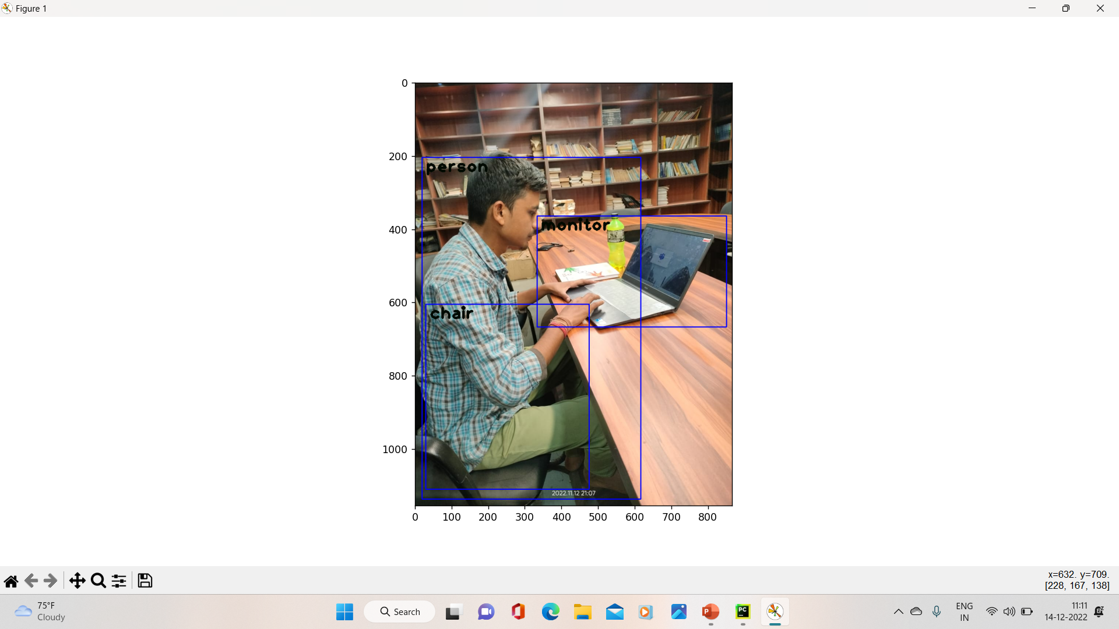

Slide 16
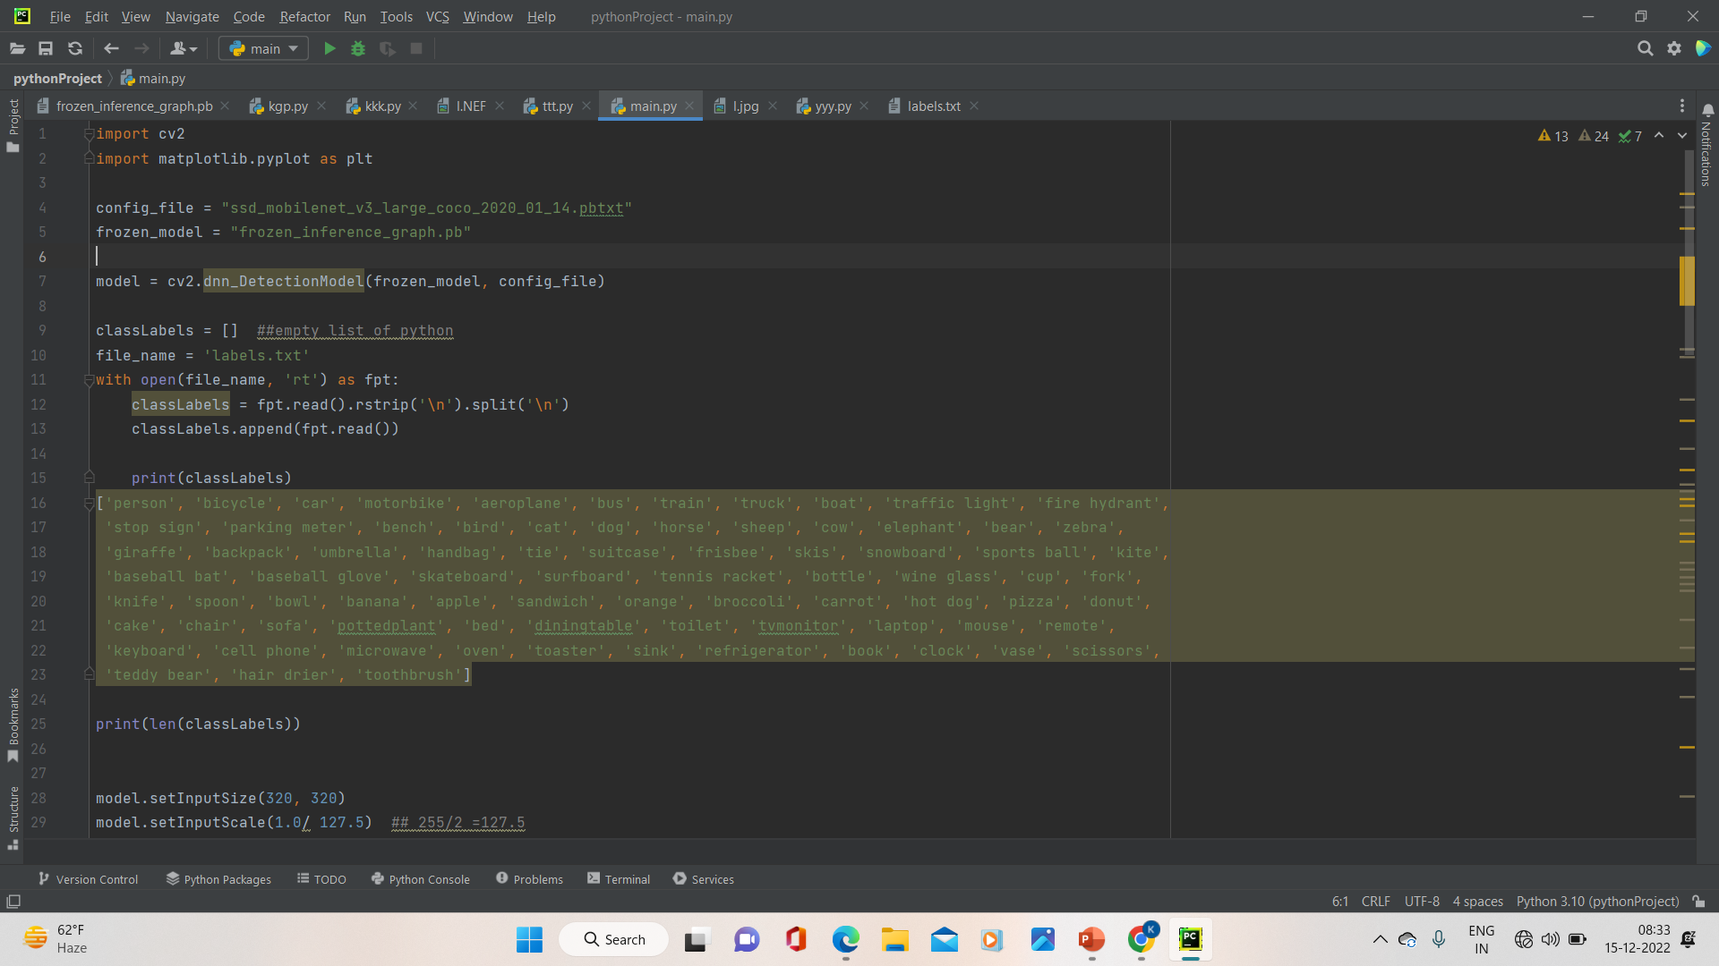
‘frozen_inference_graph.pb’
Freezing is the process to identify and save all of required things(graph, weights etc) in a single file that you can easily use. Frozen graphs are commonly used for inference in TensorFlow and are stepping stones for inference for other frameworks.

Slide 17

TECHNOLOGY USED-
MACHINE LEARNING(SSD)
SSD-SINGLE SHOT MULTIBOX DETECTOR(CNN)
Mobilenet(cocodataset)
Programming language- PYTHON
PYTHON MODULES-OPENCV, MATPLOTLIB.PLOT,OS
API-gTTs(google text to speech)
IDE(Integrated development environment)-PYCHARM(we can also implement it on jupyternotebook, spyder etc.)
ssd_mobilenet_v3_large_coco_2020_01_14.pbtxt

Slide 18
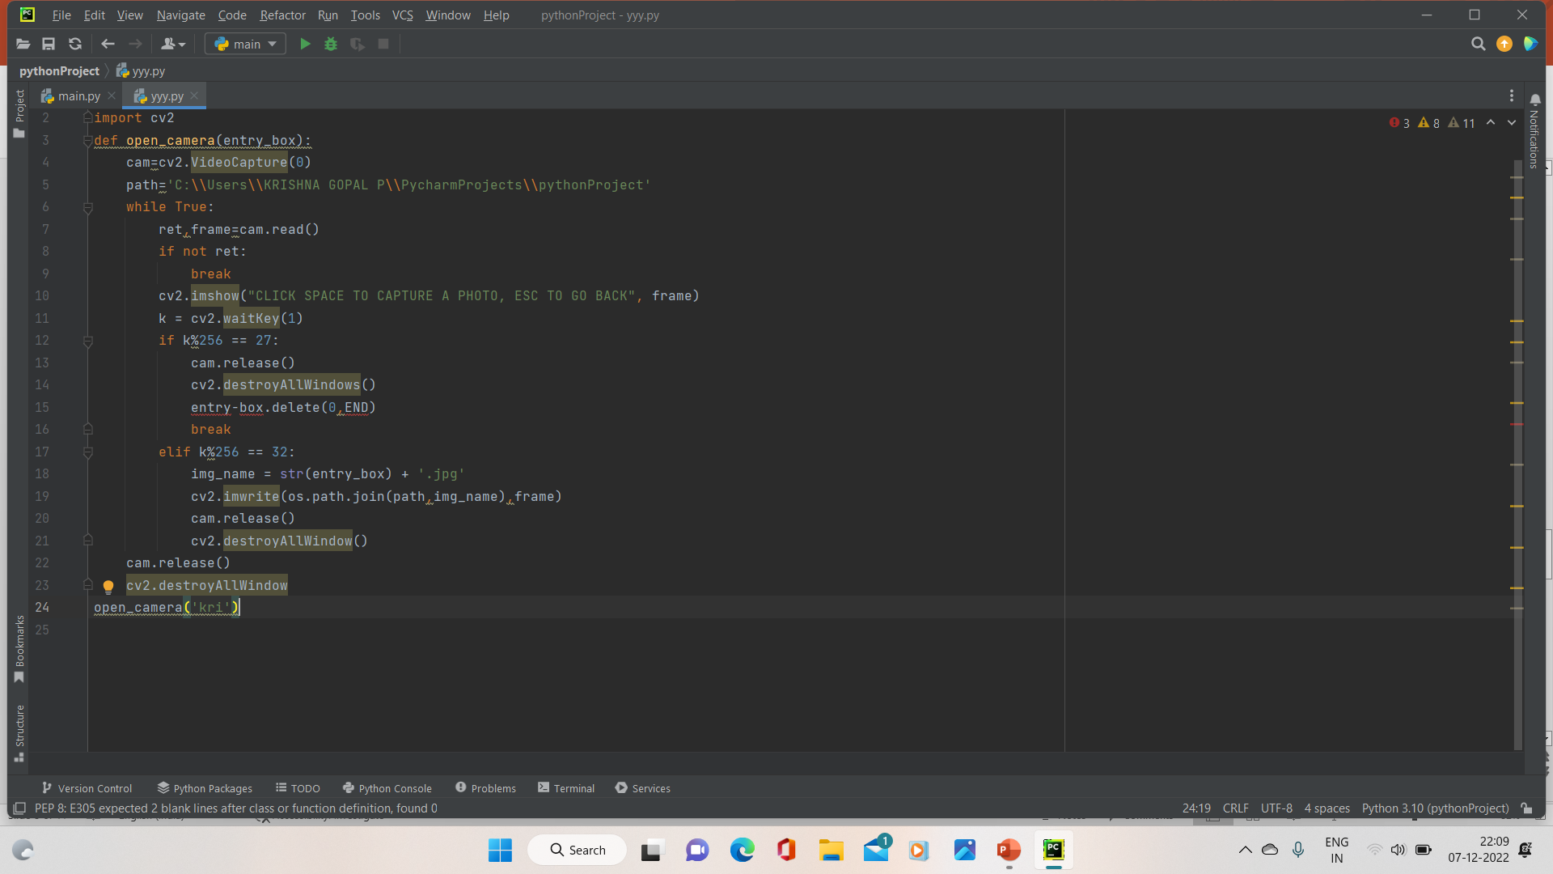
Source code- (capture image using web cam )

Slide 19
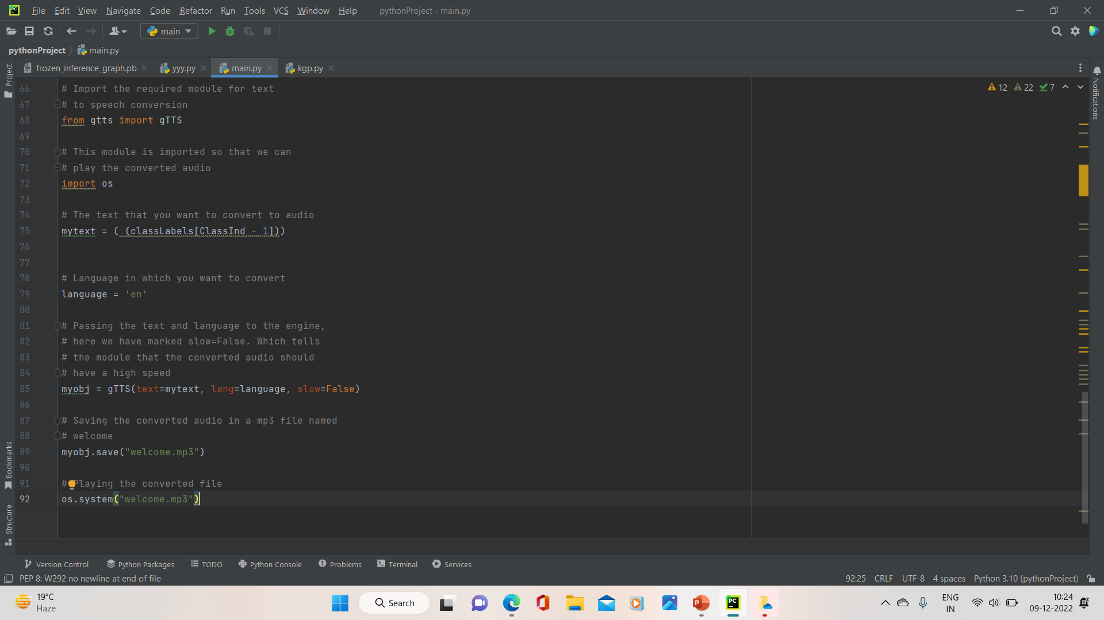
SOURCE CODE-TEXT TO SPEECH (gtTs API)

Slide 20
APPLICATIONS-
FIRST AND FOR MOST USE AS A BLIND ASSISTANCE SYSTEM.
INDUSTRY USE- MINES WHERE LOW VISIBILITY.(NIGHT VISION CAMERA)
IN DISASTER MANAGEMENT.
SECURITY AND SURVELLANCE-BOMB DETECTION ETC.
AS A WARNING SYSTEM.

Slide 21
LIMITATIONS-
Unable to calculate the distance between the different object available.
Only detect limitate items or object which are available in the machine learned dataset. (Lable text file)
For video format currently this project is not working.
ACCURACY/precision IS MAIN CONCERN.

Slide 22
FUTURE SCOPE-
It seems like real time but for us what we want to make complete real time project which can detect the objects in real time in video format
Sensor based system
In addition we can implement this project with virtual assistant.

Slide 23
RESULT-
This can detect and recognise the various categories of obstacles that may be faced while walking, objects of daily use and appliance, different types of vehicles, etc. and also provide the voice feedback of the detected/recognised object as the output.
This application is intended to help people with a visual impairement to find more precisely where objects are located through the proposed system.

Slide 25
CONCLUSION-
This study can be used widely to provide the blind with privacy and convenience in everyday life. Also, it is expected to be applied to industrial areas where diminished visibility occurs, such as coal mines and sea beds, to greatly help production and industrial development in extreme environments. The study aims to enable people with visual impairment to live more independently. People with visual impairment will be able to overcome some threats that they may come across in their day to day life that may be either while reading a book or traveling through the city by making efficient use of the application and its associative voice feedback. Therefore, it will help to prevent possible accidents. The mobile devices can be carried easily and the camera of the device can be used to detect object from the surroundings and give output in audio format. Thus, helping visually impaired people to ‘See Through the Ears.

Slide 26
THANK YOU

Slide 27
SSD(Single Shot Multibox Detector)-algorithm in object detection.
Faster than faster RCNN
It is trained over Cocodataset
Tensorflow api for object detection

